Slide 1
Project1: Investigate a Relational Database
The Sakila Database holds information about a company that rents movie DVDs. For this project, we will be querying the database to gain an understanding of the customer base, such as what the patterns in movie watching are across different customer groups, how they compare on payment earnings, and how the stores compare in their performance.

Slide 2
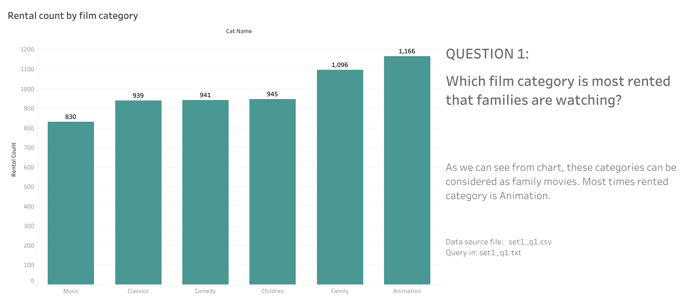

Slide 3
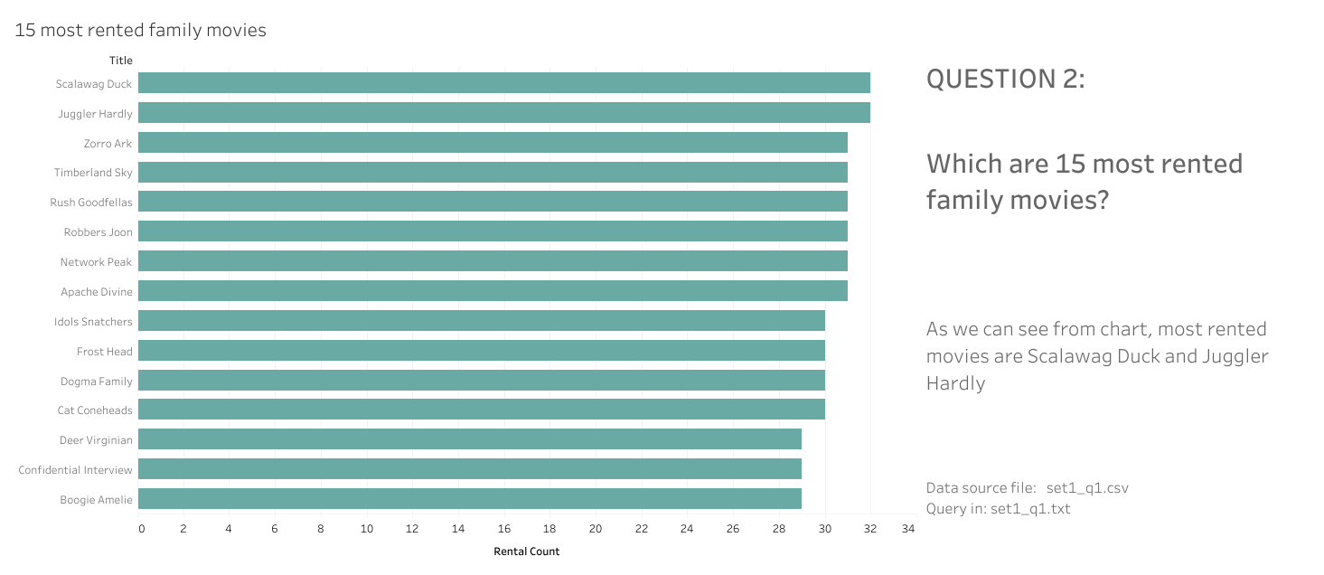

Slide 4
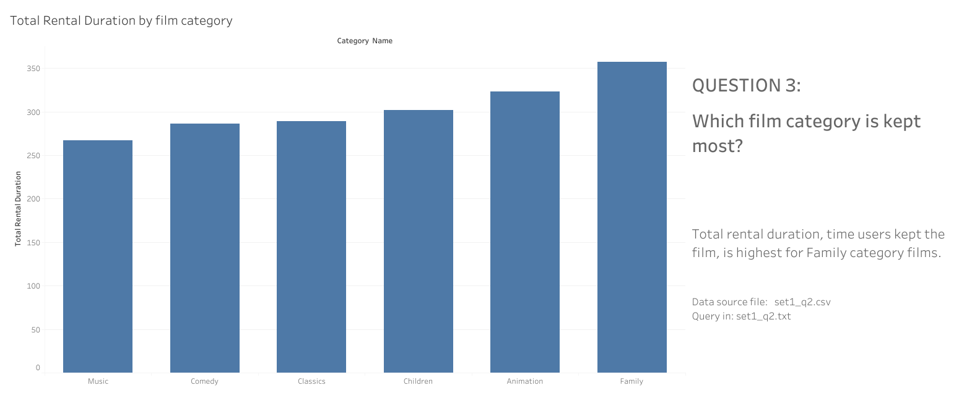

Slide 5
